Slide 1

Financial Report
Sainiaal MUSTAFa KHAN

Slide 2
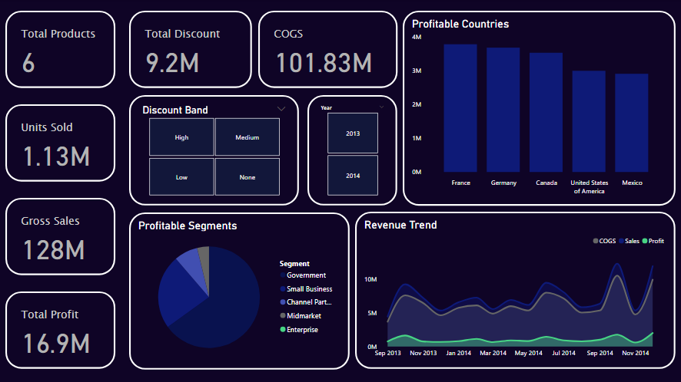
Segments
Government segment is the most popular
Enterprises generates next to nothing
Small business have potential

Slide 3
Revenue Trend
Sales generally peak in October and suddenly dips in November

